Slide 1
The Pump Problem: Intro to Inpatient Heart Failure Management
Jeffrey Tran
PGY5 Cardiology Fellow
05 August 2021
Sarver Heart Center/University of Arizona
Notes:
Hello everyone,
thank you all for coming.
I’m Jeff Tran, one of the PGY5 cardiology fellows
My goal today is to give you a step-by-step approach for caring for patients with heart failure decompensation or cardiogenic shock from the minute they hit the door.
Heart failure decompensation and cardiogenic shock are distinct entities under the umbrella of pump failure – but sometimes when you first see a patient you won’t know where they are, so we start approaching patients under the broad classification of pump failure.
Hopefully you’ll leave today a little more comfortable with how you can approach these very sick patients

Slide 2
A Consult: Ms. S
79F with:
systemic scleroderma
pulmonary hypertension (group III)
moderate RV enlargement
Brought in by family for:
- nausea/vomiting and slowing of speech.
Recent admit for LE swelling, and she had undergone IV diuresis with course c/b AKI. Discharged home after improvement.
She comes back 3 days later with the vitals below:
HR 118 (sinus tach), BP 111/69, RR 16, SpO2 100% on RA
Notes:
So the other week I got this consult from the ED.
…<read case above> …
This patient is extremely sick- she’s actively dying from cardiogenic shock- but lets break down how we can know that, what her physiology is, and how we can help her

Slide 3
Goals for Today
Who’s sick? (PGY1+)
Obtain a pertinent history and physical
Interpreting vitals
Reflex labs and diagnostics (PGY1+)
Pathophysiology of decompensated heart failure vs cardiogenic shock (PGY2+)
Toolbox for Medical Treatment (PGY2+)
Advanced care in the HF/ICU (PGY2+)
Notes:
We’re going to go through this topic based on how you’d approach a patient from the moment you see them in the ED.
First, we’ll go over the key questions to ask, followed by the things to look for on physical exam. We’ll go over the key vital signs and how all this information can give you a very good idea of how sick a patient is.
Then we’ll go over tests to order- these are pretty blind diagnostics you can order reflexively that will help triage patients further and better understand their physiology
Then we’ll talk about the physiology driving acute pump failure.
Once you have the physiology down, the medical toolbox becomes more or less intuitive.
And then finally we’ll talk about some of the advanced options we provide in the HF/ICU and what the PGY2s will get to do when they rotate with us

Slide 4
HPI – Symptoms
Congestion Symptoms
Orthopnea
Leg/belly swelling
Dyspnea (NYHA class)
Shock Symptoms
Nausea/vomiting
Lethargy/confusion
Oliguria/Anuria
Qualifying questions:
How long?
Baseline?
NYHA Class (baseline and current)
Fatigue
Can do ADLs, Can walk up 2 flights of stairs
Cannot do ADLs/walk up 2 flights of stairs without stopping to take a break
Shortness of breath at rest
Notes:
So let’s dive back in:
PGY1s, what are some of the things you talk to your patients about when you are suspecting some kind of heart failure/pump problem?
Why do you ask that question?
You ask a question because you expect a certain pathophysiologic process, and a symptom should be a downstream effect of that process. So what pathophysiologic process are you getting at? Why does HF manifest this way?
Make sure you ask about baselines. Good baseline questions are associated with a time anchor, usually a universal holiday that people can remember.
I like to break my questions congestive symptoms and shock symptoms
The green symptoms mainly suggest primary congestion, the yellow can either be a congestion or forward flow problem, and the red are scary (usually) forward flow problems. It’s not a hard and fast rule but in general be more worried about the symptoms in red

Slide 5
HPI – the Why Question
The 5 Failures
Electrical
Ischemic
Valvular
Pericardial
Myocardial
Noncompliance
Medications
Dietary
Substance use
Increased Demand
Infection
Surgery
Hyperthyroidism
Drugs
Notes:
After I begin to suspect that the patient has a congestion vs forward flow problem, the next question is why.
PGY1s- as you go through this first year, you’re going to learn that a lot of medicine is asking the correct why question.
When you suspect that someone’s cardiac function has taken a turn for the worse, you need to figure out why, because you’re going to direct your treatment at the root cause.
What’s the most common reason a patient goes into a heart failure exacerbation?
Noncompliance – dietary includes high salt loads and patients who take chronic diuretics who run out or stop taking them
Then there are the primary cardiac reasons the heart goes down, which I classify into the 5 failures. Any of these insults can trigger ADHF or CS
Finally there are the secondary reasons why a heart can fail- usually patients in this category have baseline poor cardiac function, and their reserve is depleted by these secondary factors, which leads to ADHF or CS
This doesn’t necessarily indicate how sick a patient is but it’s vital to understand why a patient decompensates because at the core of your therapeutic strategy is going to be targeted at fixing one them. That being said, typically patients with noncompliance as the etiology of their decompensation will be less sick than those whose decompensation is due to either a primary etiology or an increase in demand

Slide 6
HPI – the Caveat
#internistfirst
- Keep the differential wide
Notes:
Being a good internal medicine doctor means that you ask other questions too!
This is a heart failure talk so I’m just focusing on the HF-related questions here, but make sure you go broad on your symptoms check – for AMS use acronyms like MOIST, for edema think liver/kidney/heart etc

Slide 7
Vital Signs
Heart Rate
Very sensitive
Blood Pressure
First goes up, then goes down
Respiration Rate
Volume status
O₂ Saturation
Volume status
Urine Output
Critical indicator of end-organ perfusion
Notes:
Going over vitals is more or less straight forward, with numbers outside of your typical normal range being bad.
A few things to draw your attention to-
Blood pressure can be misleading, and the body’s first response to systemic hypoperfusion is to clamp down, resulting in relative hypertension. As time goes on, you lose this effect and the patient becomes hypotensive. You’re never sure where you are in this range, so even normal blood pressure can hide something very bad going on
Heart rate is the most nuanced indicator of something wrong going on. Sinus tachycardia is in general a bad sign. Patient’s don’t get bradycardic unless the electrical failure is their driving etiology or they’re about to die due to extreme electrolyte or acid/base disturbances.
The RR and SpO2 give evidence of where congestion may be occurring, and offers an easy target for therapy if SpO2 starts to drop
I include UOP as a vital sign because the kidneys are the most sensitive indicator of end organ perfusion. Knowing your UOP is critical to management of sick HF patients

Slide 8
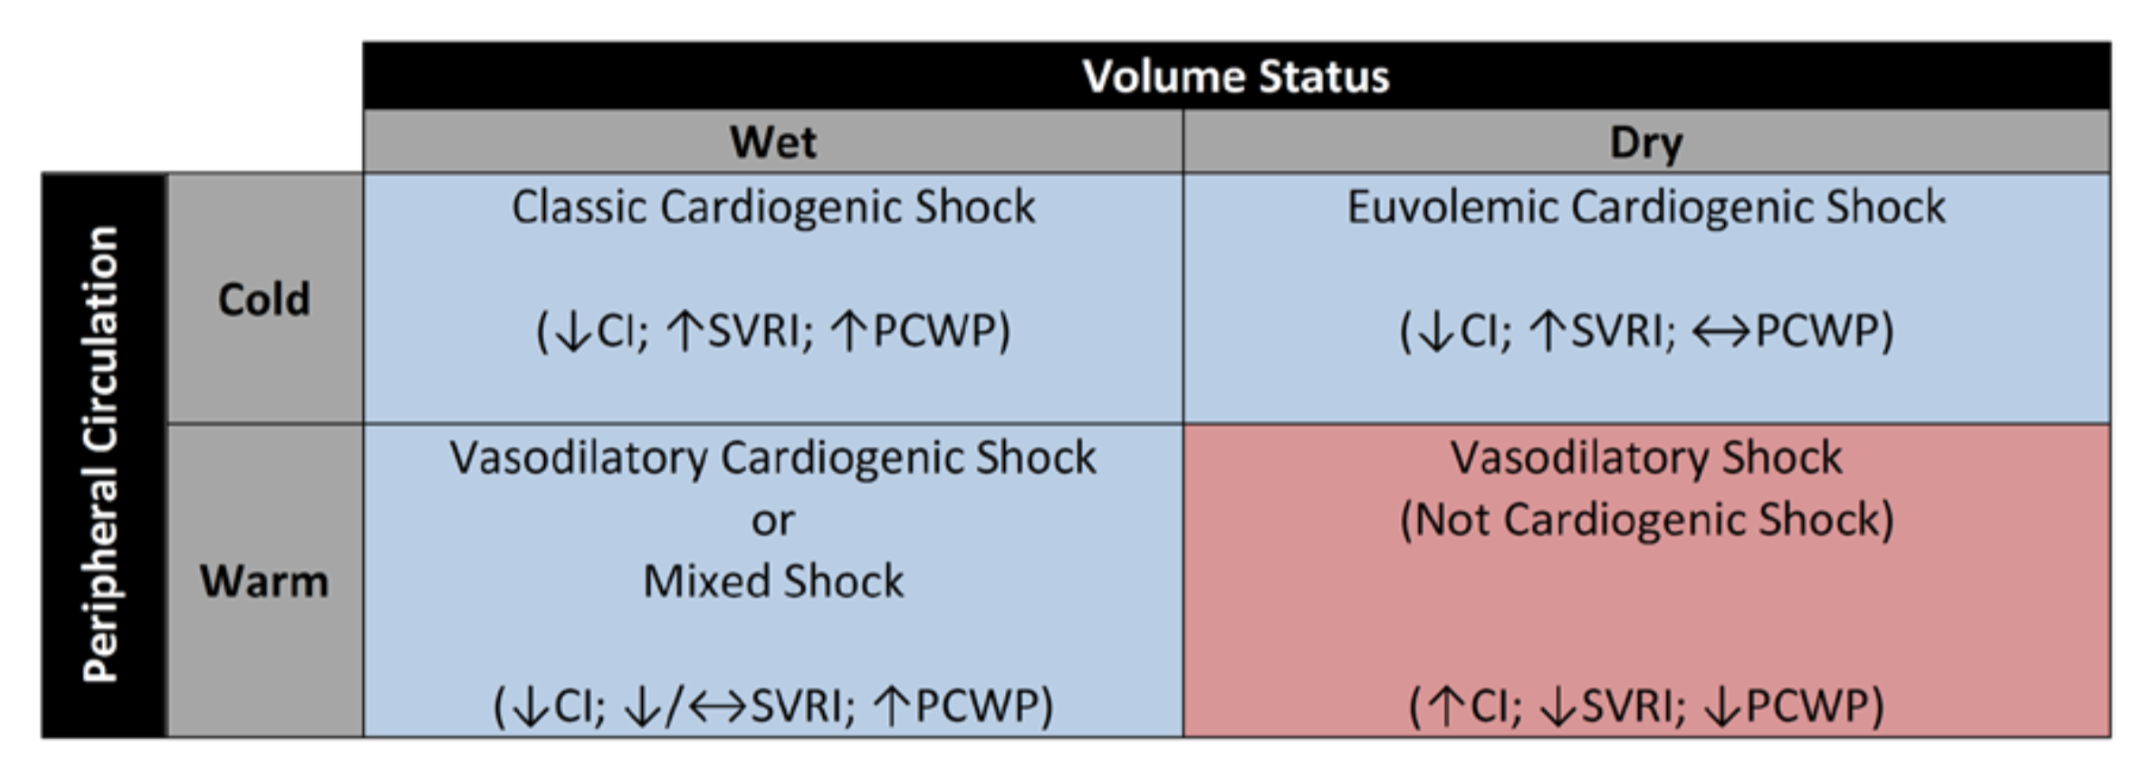
Physical Exam – warm/cold, wet/dry
Notes:
The physical exam is a great tool for understanding how sick your patient is. A nice construct is the warm/cold vs wet/dry construct.
Cold in general is bad – now of course it’s not specific but you’re scared that the ”coldness” is reflecting increased peripheral arteriole constriction as compensation for generally poor forward flow.
Wet indicates the fluid is for some reason backing up.
So sicker patients are typically cold and wet, but pump failure problems present as any of the boxes in blue. There are definitely cases of euvolemic cardiogenic shock where patients appear cold and dry, and patients with acute congestive heart failure can appear warm and wet.
The cold/warm exam is also nice because it’s easy. Grab your patient’s leg and you can figure out if your patient is cold really fast.

Slide 9
Physical Exam – wet or dry?
Crackles on lung exam
+JVD/HJR
Dependent edema
Orthopnea
“the hepatojugular reflux … predicts PCWP greater than or equal to 15 mmHg. Some studies have also noted a high specificity of about 96%”
- Marantz PR, et al. Chest. 1990
JVP:
30-45º: cm above clavicle + 6cm
Upright: cm above clavicle + 10cm
Flat: useless
Notes:
In terms of the remainder of the exam, the goal is to confirm patients symptoms and to figure out where the fluid may be
Most of these physical exam proceedings are self explanatory but what is the difference between JVD and JVP?
How do you measure JVP?
What about HJR?

Slide 10
Recap: Who’s sick?
Wet or dry?: NYHA class, dependent edema, orthopnea
Shock?: Lethargy and decreased UOP are red flags
Why? – the 5 failures, noncompliance, and increased demand
Tachycardia is the most sensitive, BP can be misleading, follow the UOP!
Cold/lethargic is BAD, the rest of the physical exam is for figuring out volume status and confirming symptoms from the HPI

Slide 11
Ms. S
Baseline NYHA, no new orthopnea, no new dependent edema
Lethargic
Normal BP, normal RR/SpO2
Tachycardic, Oliguric (per family)
COLD, dry

Slide 12
Goals for Today
Who’s sick? (PGY1+)
Obtain a pertinent history and physical
Interpreting vitals
Reflex labs and diagnostics (PGY1+)
Pathophysiology of decompensated heart failure vs cardiogenic shock (PGY1+)
Toolbox for Medical Treatment (PGY2+)
Advanced care in the HF/ICU (PGY2+)

Slide 13
Reflex Lab Tests
Lab | What you’re looking for
NTproBNP* | Value < age-adjusted cut off rules out HF
Lactic acid | Cardiogenic shock?
hs-Troponin | Etiology of decompensation
Serum Creatinine | How much diuretic are you going to have to use? How sick is your patient?
Serum Potassium | How recent is your acute renal injury?
Age | NTproBNP cutoff
<50 | ≥ 450
50-75 | ≥ 900
>75 | ≥ 1800
*age-adjusted cutoffs for NTproBNP
Remember: order the rest of your labs to work through your differential diagnosis!
Notes:
The reason we get labs/diagnostics is to confirm/refute our diagnosis, to further triage our patients, and if they have HF, to figure out what’s the cause
Here’s a quick set of labs to grab for all your HF patients

Slide 14
Reflex Diagnostics
Test | What you’re looking for
Chest XR | Where’s the fluid? – this isn’t sensitive!
EKG | Etiology- ischemic vs electrical
POC TTE | Etiology- pericardial, valvular, myocardial, ischemic; RV involvement?
EF does not equal forward flow!
Remember: order the rest of your diagnostic imaging to work through your differential diagnosis!
Notes:
Here’s a quick set of diagnostic test to get for pretty much all your HF patients
I can’t emphasize enough the importance of an echocardiogram. The sicker the patient, the more it matters to get an echo early. It’s an important skill for any internist to be able to do their own echo, something I think I’m going to come back and talk to you guys about later in this lecture series.

Slide 15
Recap: What tests should I order?
Labs:
- NTproBNP, troponin, BMP, lactic acid
Diagnostics:
- CXR, EKG, POC echocardiogram

Slide 16
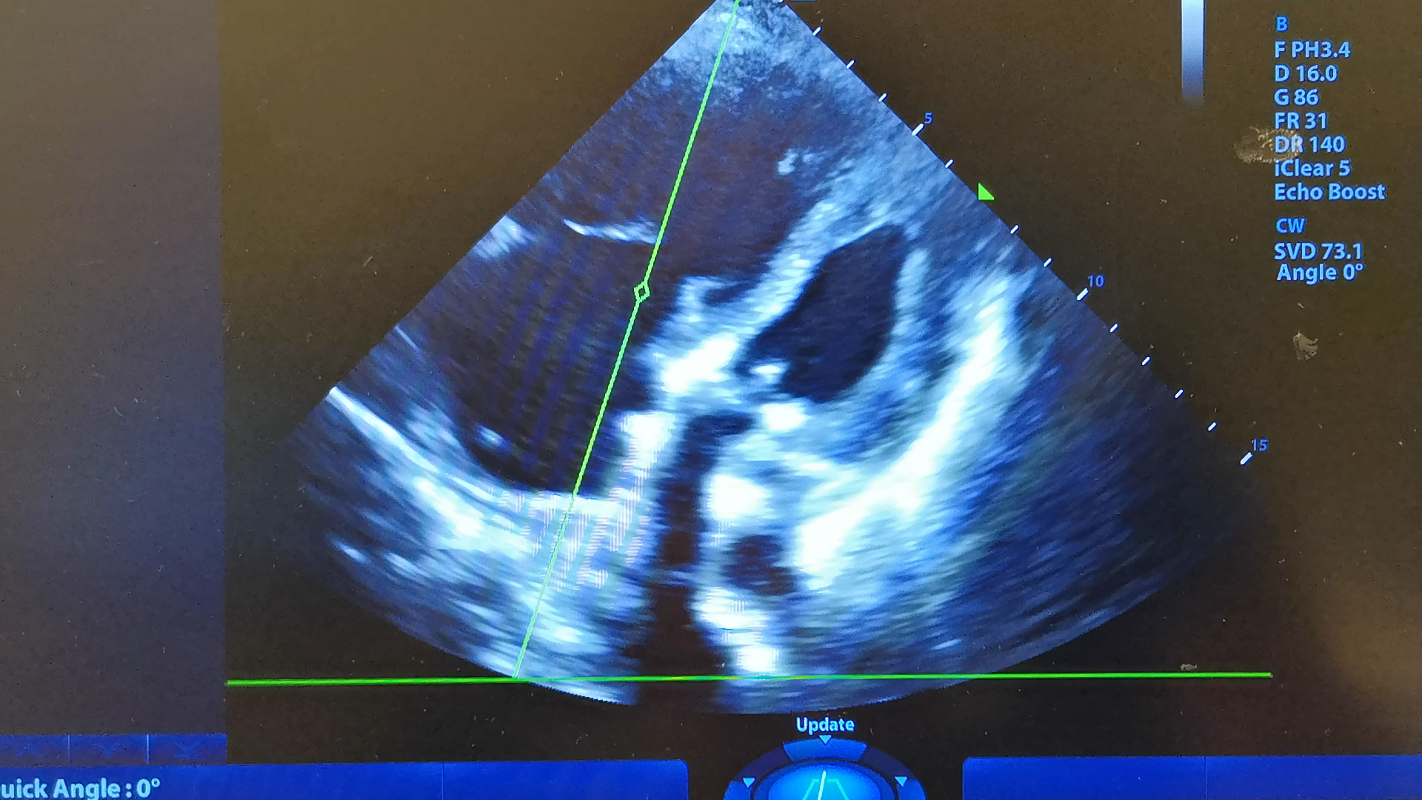
Ms. S
NTproBNP 2132
Hs-trop 113
Cr 3.23 (dc was 2.1)
Potassium 4.9
Lactic acid: 7.8
CXR: no congestion
EKG: Sinus tachycardia with RBBB (baseline)
Echo: severely enlarged RV with mild dysfunction, IVC-based RAP 8mmHg

Slide 17
Goals for Today
Who’s sick? (PGY1+)
Obtain a pertinent history and physical
Interpreting vitals
Reflex labs and diagnostics (PGY1+)
Pathophysiology of decompensated heart failure vs cardiogenic shock (PGY1+)
Toolbox for Medical Treatment (PGY2+)
Advanced care in the HF/ICU (PGY2+)
Notes:
Up to this point, we’ve been making subtle distinctions between decompensated heart failure and shock, but let’s map these terms back to physiologic processes

Slide 18
Decompensated Heart Failure vs Cardiogenic Shock
Decompensated heart failure
Cardiogenic shock
Inability of the heart to handle a certain volume, resulting in fluid back up (congestion)
Inability of the heart to provide adequate perfusion to the end-organs
Notes:
What do you guys think is the difference between cardiogenic shock and congestive heart failure?
So ultimately, one’s a back up problem, one’s a forward flow problem
Note you can have cardiogenic shock outside of congestion – such as Ms S’s case – which is called euvolemic cardiogenic shock

Slide 19
PV loops and the Cardiac Cycle
Aortic valve closes
Systole
Aortic valve opens
Pressure
Isovolumic Relaxation
Isovolumic contraction
Mitral valve closes
Mitral valve opens
Diastolic filling
Volume
Notes:
To understand why we should distinguish between these concepts, we have to understand the physiology a little better
For this we turn to one of my favorite topics: pressure volume loops.
Here’s a flash back from med school:
Here’s our pressure-volume axis
Well start with diastolic filling, then we have isovolumic contraction, followed by the opening of the aortic valve into systole. The aortic valve then closes, the ventricle relaxes, and we start over again.
This is the cardiac cycle.

Slide 20
PV loops and the Cardiac Cycle
Blood pressure
Pressure
Stroke volume
Volume
Notes:
There are some really interesting things we can get out of the cardiac cycle
Stroke volume is here and blood pressure is here

Slide 21
PV loops and the Cardiac Cycle
Elastance_{arterial}
inotropy
Blood pressure
Pressure
Stroke volume
Volume
Notes:
Next we can draw some interesting lines – the first is inotropy, which is how hard the heart contracts per unit of filling volume.
The next is end arterial elastance, which is similar to the concept of afterload
Now this is what the cycle looks like in you and me- the large slope of the inotropy curve translates to a robust stroke volume per cardiac cycle.

Slide 22
PV loops and the Cardiac Cycle
Elastance_{arterial}
inotropy
Blood pressure
inotropy
Pressure
BP
Stroke volume
Stroke volume
Volume
Notes:
But in a pump failure patient, the inotropy curve is shifted very far down, which pulls the blood pressure down and reduces the stroke volume

Slide 23
PV loops and the Cardiac Cycle
Elastance_{arterial}
Elastance_{arterial}
inotropy
Pressure
BP
BP
Stroke volume
Stroke volume
Volume
Notes:
To compensate the small arterioles clamp down, which shifts the Ea curve upwards.
this pulls up the blood pressure, but at the cost of our stroke volume
The overall result of the decrease in inotropy and the increase in Ea is that there is a change in the BP with a significant decrease in stroke volume. To further compensate, we know that CO = SV x HR, so the HR picks up and the patient becomes tachycardic
Is this relationship between inotropy, afterload, stroke volume, and BP clear? Managing pump failure patients pretty much comes down to understanding these relationships

Slide 24
Recap: What are the key parameters in pump failure pathophysiology?
Pump failure is ↓cardiac output:
↓cardiac output => ↓ blood pressure, ↓ stroke volume (perfusion)
To compensate:
↑afterload => ↑blood pressure, ↓ stroke volume (perfusion)
↑heart rate => ↑ cardiac output (CO = SV x HR)
So the pump failure state is often:
↓ ↓ stroke volume, ↑heart rate, BP can be high, low, or normal
Notes:
Here’s a quick summary

Slide 25
Ms. S
CO: ↓
Afterload: ↑
BP: normal
HR: ↑

Slide 26
Goals for Today
Who’s sick? (PGY1+)
Obtain a pertinent history and physical
Interpreting vitals
Reflex labs and diagnostics (PGY1+)
Pathophysiology of decompensated heart failure vs cardiogenic shock (PGY1+)
Toolbox for Medical Treatment (PGY2+)
Advanced care in the HF/ICU (PGY2+)
Notes:
So based on this, how do we help our patient?

Slide 27
Medical Tools for Pump Failure
Increase Inotropy
Decrease Afterload
Preload reduction
Inotropes

Slide 28
Increasing Inotropy by Decreasing Preload: the Starling Curve
Stroke Volume
Normal heart
sv₂
Congestive Pump failure
sv₁
LV End Diastolic Volume (preload)
Notes:
To understand what’s going on, we have to revisit the starling curve, which basically says that the more volume you have at the start of systole, the stronger your ventricles will contract to eject that volume… up to a point. Beyond that, the ventricle starts to have diminishing inotropy.
In pump failure, we reach this magical point at a far lower preload than the normal heart, and the maximum inotropy is much lower.
We can help our congested pump failure patients by removing that volume, which theoretically will increase their inotropy

Slide 29
Medical Tools for Preload Reduction
Increase Inotropy
Decrease Afterload
Preload reduction
Diuresis
Venodilators
Inotropes
Notes:
So the question becomes how do we perform preload – from the medicinal side we have two options: diuresis and venodilators

Slide 30
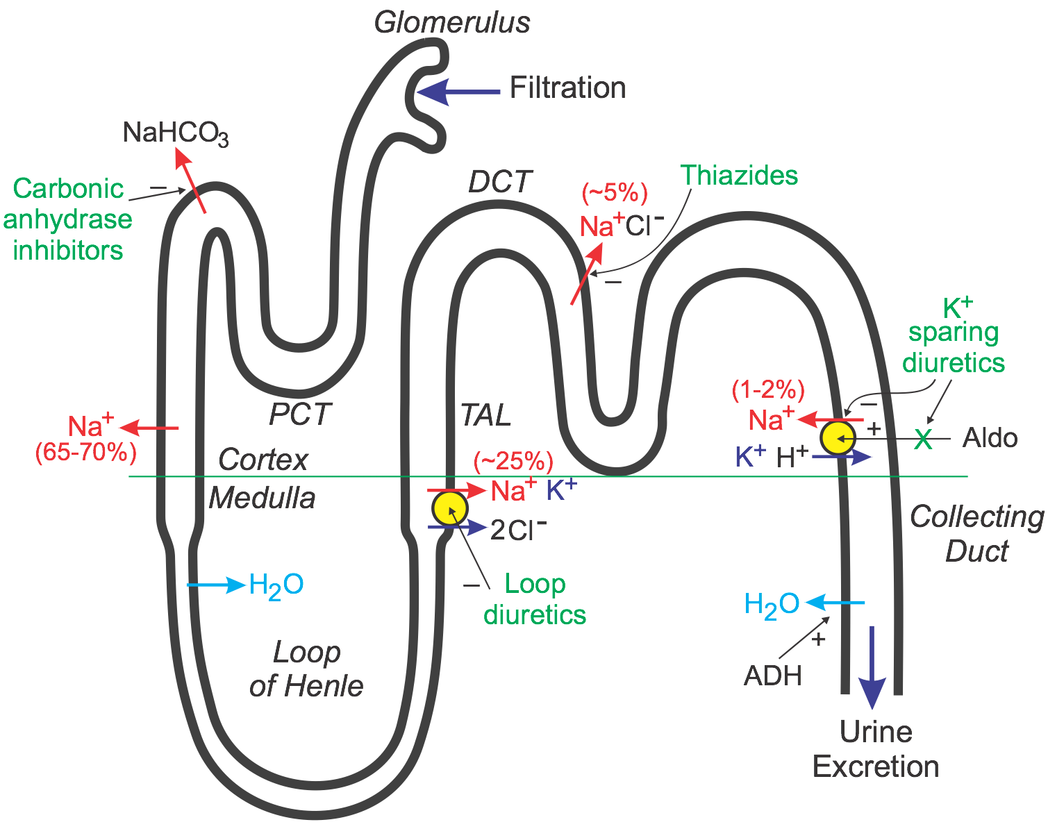
Medical Tools for Preload Reduction: diuretics
Diuretic | PO Lasix Ratio | Half Life
Loop Diuretics
Furosemide IV | 20:40 | 2 hrs
Bumetanide IV | 1:40 | 4-6 hrs
Torsemide | 10-20:40 | 3.5 hrs
Ethacrynic Acid IV | 50:40 | 2 hrs
Thiazide Diuretics
Metolazone | -- | 14 hrs
Hydrochlorothiazide | -- | 6-15 hrs
Bendroflumethiazide | -- | 3-8.5 hrs
Vasopressin Antagonists
Tolvaptan | -- | 12 hrs
1) diuretic choice
2) continuous vs intermittent infusion
3) combination diuretics
Vasopressin antagonists
Titrate to UOP goal > 1-2cc/kg/hr
NOTE: do NOT routinely fluid restrict your patients
Notes:
Your therapeutic options are diuretics and RRT
Diuretic options are splint into loop diuretics, thiazide diuretics, and vasopressin antagonists. Patients with pump failure are often diuretic resistant due to concomitant CKD and are frequently in cardiorenal syndrome, and so frequently require a much higher dose of diuretic.
The questions that typically arise when selecting a diuretic regimen are:
which diuretic to choose
continuous vs intermittent infusion and
how to use combination diuretics when a single agent is insufficient.
Diuretic strategies often involve the combination of multiple diuretics, the most popular of which is loops diuretics + thiazides as well as using the loop diuretic as a bolus + continuous infusion rather than just intermittent infusions.
There is no data to suggest that continuous infusion is superior to intermittent bolus. Similarly strategies such as albumin sandwich, hypertonic saline boluses, and renally dosed dopamine have not been shown to have any benefit
Obviously, CRRT is the last option even though it allows for optimal rate of fluid removal, largely due to monetary costs, nursing requirements, and hemodynamic burden on an already tenuous patient.

Slide 31
Medical Tools for Preload Reduction: organic nitrates
PO:
Isosorbide dinitrate
Isosorbide mononitrate
Cutaneous:
Nitroglycerin patches
IV:
Nitroglycerin gtt*
Increase Inotropy
Preload reduction
Diuresis
PO Venodilators
IV Venodilators
Inotropes
Caveat: fluid shifting, not fluid removal. May decrease renal diuretic threshold, increasing diuretic efficacy
Titrate to symptoms and UOP goals
*BEWARE: NTG gtt tachyphylaxis (>24-48hrs); It’s only buying you a window of time to get the fluid out!
Notes:
In terms of venodilators, we have PO and IV venodilators
Be thoughtful about your use of venodilators. If you think about it, they are not a long term solution- they’re simply increasing venous capacitance, shifting preload away from the heart.
This really comes into play when using a nitro gtt – you can see drastic improvements in symptoms with a nitro gtt, but it’s a false sense of security because in reality the fluid still in the body. For those precious hours it works, renal congestion is decreased, which may be a/w a lower diuretic threshold. That is your window to get the fluid out!

Slide 32
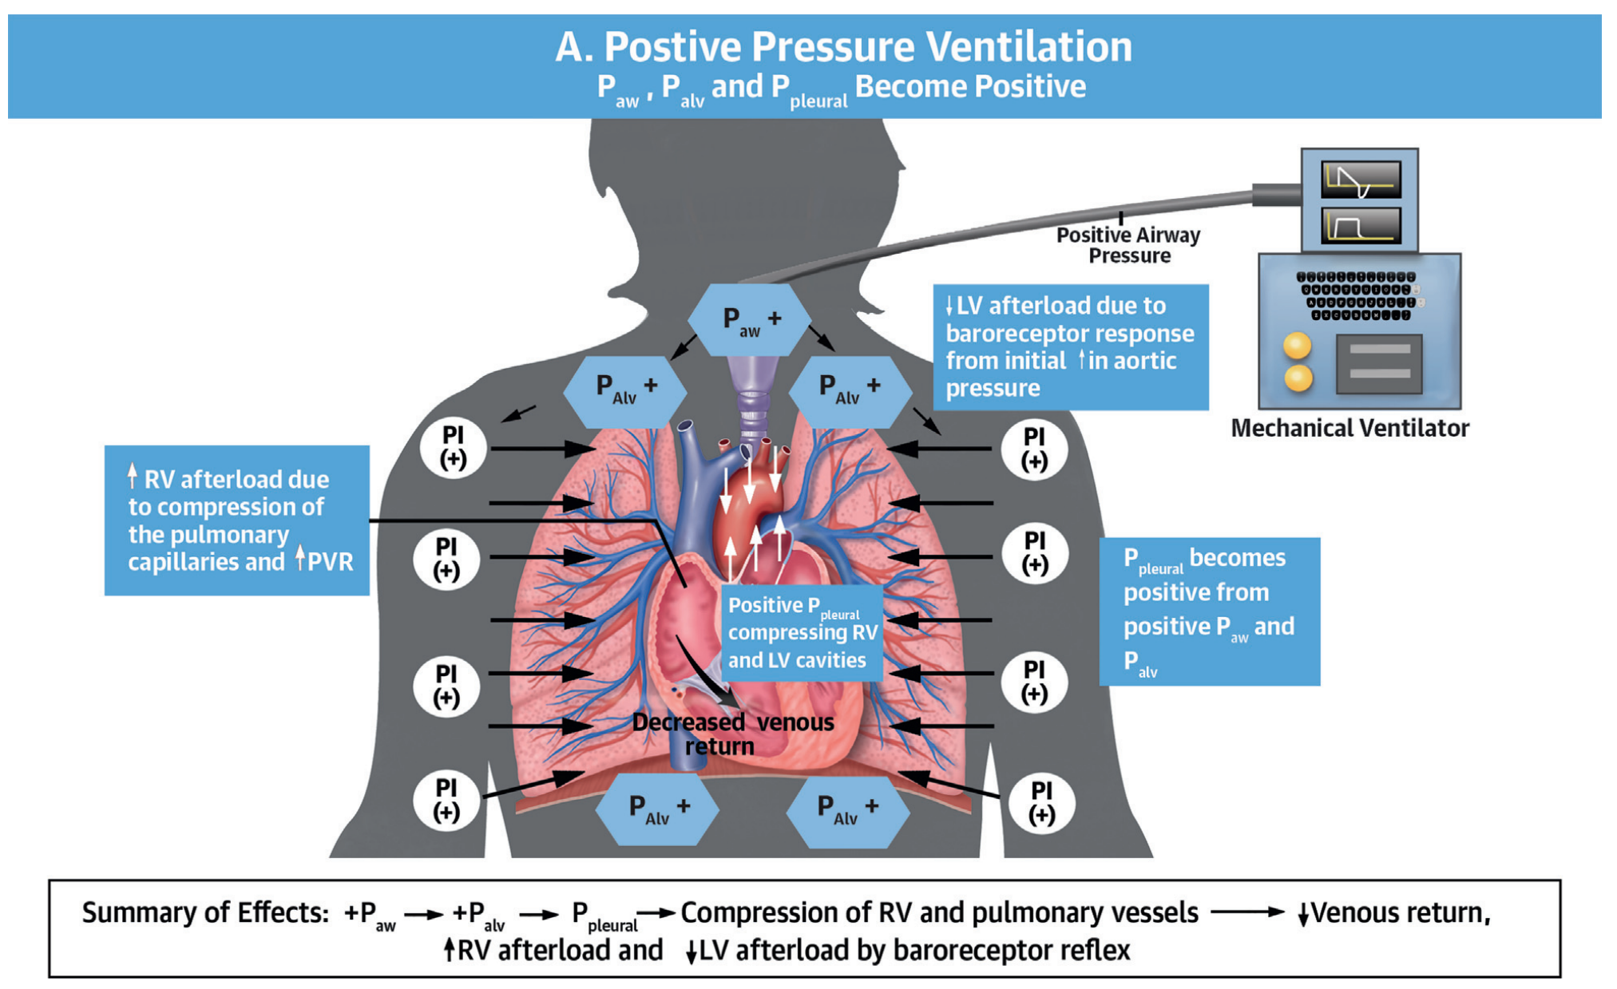
Mechanical Tools for Pump Failure: Positive-Pressure Ventilation
Increase Inotropy
Preload reduction
Diuresis
PO Venodilators
BiPAP
IV Venodilators
Hemodynamic effects of PPV:
↓preload
↓LV afterload
↑RV afterload
Notes:
So that pretty much exhausts the medical options for preload reduction, but there’s a mechanical form of preload reduction- BiPAP! Or more generally any mode of positive pressure ventilation.
PPV is actually pretty complicated in terms of its effects on hemodynamics- it does a lot of good stuff, and some bad stuff, such as increasing RV afterload, but as long as you don’t have severe RV failure the RV will do just fine.

Slide 33
Medical Tools for Pump Failure
Increase Inotropy
Preload reduction
Diuresis
PO Venodilators
Increasing level of care/ side effects
BiPAP
IV Venodilators
Inotropes
Notes:
That’s all for our tool box for preload reduction. Now let’s talk inotropes.
As you move from the top to bottom of this diagram, the medications have increasing adverse effects and subsequently require increasing level of care.
Inotropes, as you can see, are towards the bottom- this is because of the method through which they work, which is namely to increase the amount of calcium released from the sarcoplasmic reticulum. In addition to leading to an increase in contractility, this also increases automaticity, which translates to an increase in arrhythmias. Hence we generally avoid using these medications unless absolutely necessary.

Slide 34
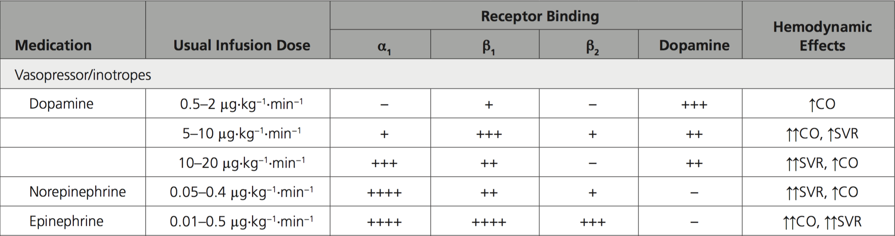
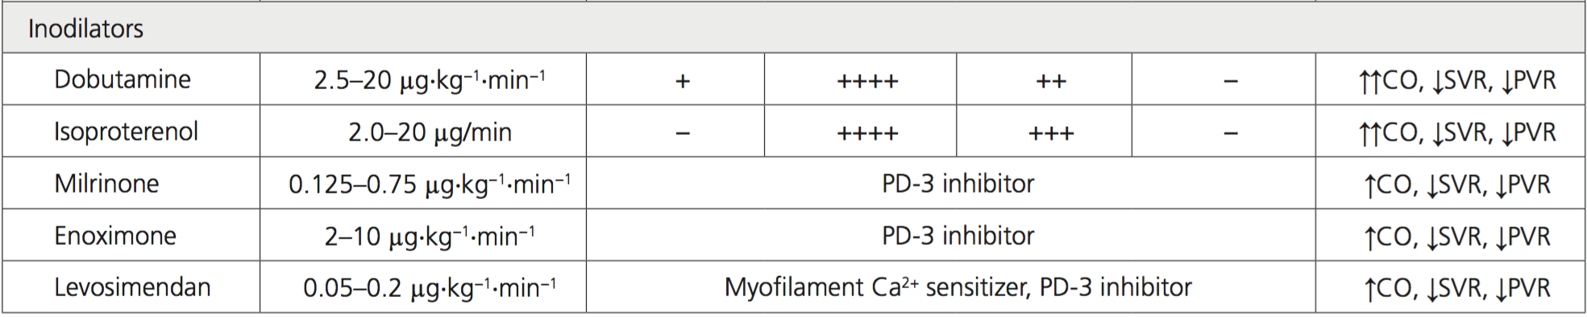
Inotrope/Vasopressor Options
Notes:
We have a lot of options for inotropes, and while this table is important know for your medicine training, I want you to focus on dopamine, dobutamine, and milrinone
The plus signs, indicate which receptors these medicaitons act on. We’ll end up choosing an inotrope based on which receptor it acts on. In the most simplified sense, alpha activity increases afterload, beta activity increases inotropy.
So our work horse drug ends up being dobutamine as it acts on a lot of beta1 receptors and very little alpha.
In contrast, we see that dopamine has much more alpha per beta1 activity. So why would we ever use dopamine? The short answer is that not all pump problem patients have high afterload, and there is a limit to how low we can push afterload. At some point, the afterload is so low, it does not sustain a survivable blood pressure. Sometimes we need a little more afterload to keep the organs perfused.

Slide 35
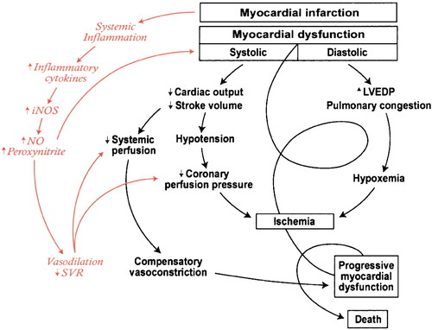
The Cardiogenic Shock Spiral
Notes:
This happen a lot more in cardiogenic shock- as organs become increasingly ischemic, the inflammatory cascade is activated resulting in pathologic vasodilation.
Dobutamine, despite its existing alpha activity, can be unpredictable in its blood pressure effects.
When patients are too tenuous to deal with this unknown, we turn to dopamine, as it tends to be more consistently pressure neutral.

Slide 36
Inotrope/Vasopressor Options
Notes:
A HUGE word of caution here: do NOT titrate inotropes to blood pressure. If your monitoring suggests to you that the patient is developing pathologic vasodilation, use norepinephrine/vasopressin/then epi (basically follow your surviving sepsis campaign guidelines)
The final inotrope to discuss is milrinone, a PDE-3 inhibitor.

Slide 37
Milrinone
inotropy
↓E_{a}
Stroke volume
Notes:
This medication both increases inotropy and decreases afterload, for a large increase in stroke volume with little impact on blood pressure

Slide 38
Medical Tools for Pump Failure
Increase Inotropy
Preload reduction
Diuresis
PO Venodilators
BiPAP
IV Venodilators
Increasing risk of use/ required LoC
Inotropes
Dopamine
Dobutamine
Milrinone
Use as afterload ↑
Notes:
So in quick summary,
Use dopamine for cardiogenic shock when afterload is very low, eg there is a vasodilatory component; make sure to use NE/vaso to get to your BP target.
Use dobutamine when your afterload is at target
And use milrinone when you have CS + pathologic vasoconstriction
Note these drugs are towards the bottom of the diagram, eg they have quite a few side effects and should not be used unless you absolutely have to. – basically they’re your last resort medical therapy.

Slide 39
Medical Tools for Pump Failure
Increase Inotropy
Decrease Afterload
Preload reduction
Diuresis
PO Venodilators
PO arterial dilators
BiPAP
IV Venodilators
Increasing risk of use/ required LoC
IV arterial dilators
Inotropes
Dopamine
Dobutamine
Milrinone
Use as afterload ↑
Notes:
We can insert our afterload reducers to the right of the diagram, where our high afterload patients are. Note that these medications are well tolerated…

Slide 40
Medical Tools for Pump Failure: afterload reduction
Oral
IV
ACEI/ARB/ARNI
Hydralazine
nitroprusside
Notes:
To round out our discussion on medical therapy for pump failure, we can add our afterload reducers

Slide 41
The mechanism of afterload reduction
inotropy
↓E_{a}
Stroke volume
Notes:
…and can give us significant forward flow with little decrease in blood pressure when our inotropy slope is low

Slide 42
Recap: Medical Tools for Pump Failure
Patient is congested:
Diuresis!!!
Imdur/Isordil/NTG gtt: temporary solution to facilitate diuresis
BiPAP/PPV: for pulmonary edema; avoid in acute RV failure
Patient has high afterload:
ACEI/ARB/ARNI/hydralazine/nitroprusside gtt:
Well tolerated, a lot of benefit, may need close monitoring
Shock (decreased perfusion causing end organ damage)
Inotropes: Dopamine/Dobutamine/Milrinone
Selection depends on afterload state
Notes:
In summary,

Slide 43
Ms. S
Congested?
Afterload?
Shock?
Milrinone!

Slide 44
Extra Section: monitoring and titrating
Inotropes
IV afterload reduction
End-organ markers!
Lactate, UOP, SCr, mentation
Cardiac output/index
Goal CI ≥ 2.2
NOT GREAT
Serial indirect Fick measurements?
SvO2 from high CVC
Afterload ~ SVR
Goal 800-1000
PA catheter is your friend
Notes:
A points of caution regarding managing medications such as inotropes and nitroprusside:
Namely, how?

Slide 45
Goals for Today
Who’s sick? (PGY1+)
Obtain a pertinent history and physical
Interpreting vitals
Reflex labs and diagnostics (PGY1+)
Pathophysiology of decompensated heart failure vs cardiogenic shock (PGY1+)
Toolbox for Medical Treatment (PGY2+)
Advanced care in the HF/ICU (PGY2+)
Notes:
We’re going to go through this topic based on how you’d approach a patient from the moment you see them in the ED.
First, we’ll go over the key questions to ask, followed by the things to look for on physical exam. We’ll go over the key vital signs and how all this information can give you a very good idea of how sick a patient is.
Then we’ll go over tests to order- these are pretty blind diagnostics you can order reflexively that will help triage patients further and better understand their physiology
Then we’ll talk about the physiology driving acute pump failure.
Once you have the physiology down, the medical toolbox becomes more or less intuitive.
And then finally we’ll talk about some of the advanced options we provide in the HF/ICU and what the PGY2s will get to do when they rotate with us

Slide 46
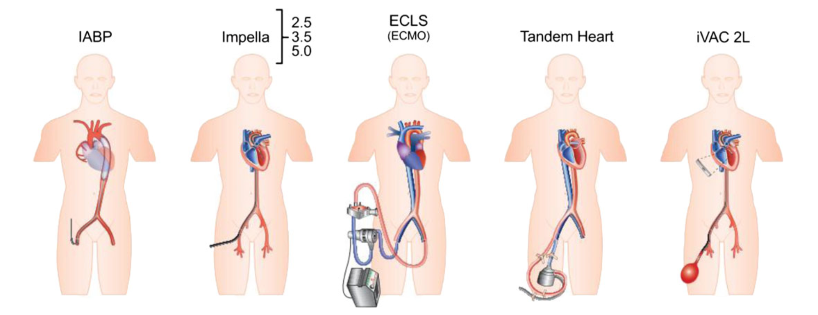
Mechanical Circulatory Support Options
Notes:
There has been an explosion in advances over the last few years, and device companies have provided us with a plethora of new options to accomplish the three aforementioned goals. For the sake of time, I’m only going to talk a few devices.

Slide 47
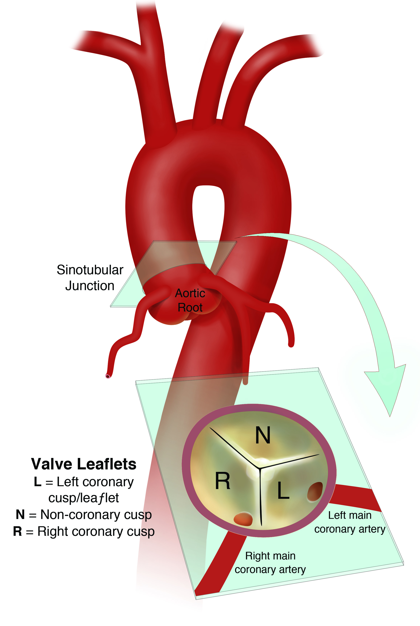
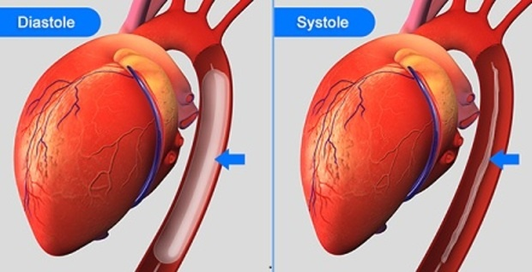
MCS: the IABP – Theory
Notes:
The intra-aortic balloon pump is the oldest MCS device, the most studied, and the most popular. It goes all the way back to 1962, and is still used today!
The IABP consists of a balloon that inflates during diastole and deflates during systole based (most frequently) on continuous EKG or (rarely) a pressure transducer at the tip of the balloon. The inflation during diastole forces blood to the aortic root and into the coronary arteries, increasing their perfusion. This has obvious benefits in AMI-related CS, where coronary flow is the issue.
But also because of the back flow to the AV valve, the IABP is contra-indicated in severe AI.
During systole, the IABP deflates, creating a vacuum like effect, with VERY small decreases in systemic SVR. The kicker to this is WHERE the decrease in SVR is happening. The central placement of the IABP immediately superior to the crucial renal and splanchnic arteries means that blood ejected from even the weakest of hearts has minimal resistance to getting to the critical central organs. Patients can go from anuric to normal renal function in a matter of hours after an IABP has been placed.
In terms of our achieving our three goals of an MCS, the IABP is very good at achieving coronary perfusion, but it’s level of circulatory support is highly dependent on native LV function- in cases of profound LV function, the IABP provides insufficient support. And finally the IABP provides only small levels of ventricular unloading. It does nothing to reduce LVEDP/volume and has only minimal impacts on reducing LV pressures through it’s minimal reductions in systemic vascular resistance.

Slide 48
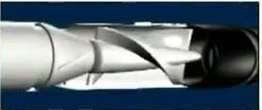
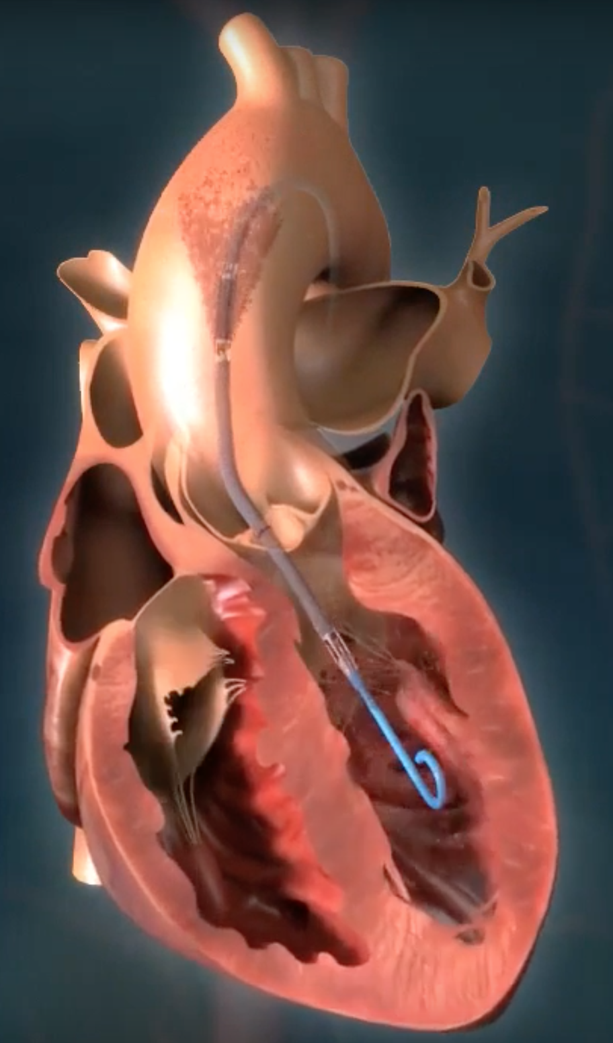
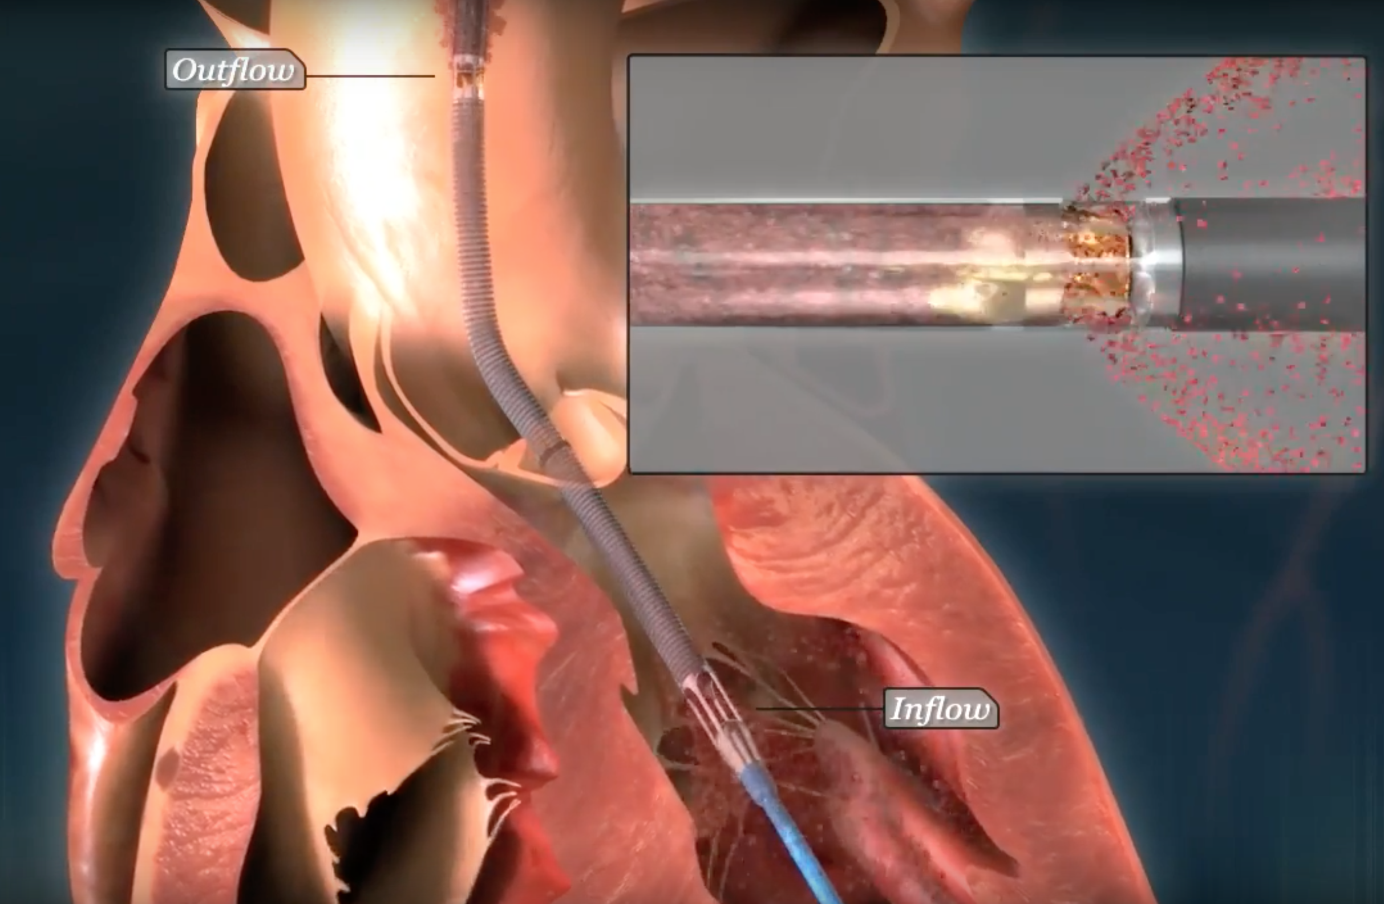
MCS: the Impella – Theory
Notes:
As we touched on before, the IABP is not able to provide large amounts of circulatory support in patients with extremely poor LV function and it’s LV unloading abilities are minimal. The Impella is a micro axial flow device that provides greater circulatory support and significant LV unloading. It comes in various sizes, 2.5, 3.5 (CP), and 5.0, but the 5.0 is used very infrequently here as a CTS team has to place it.
The Impella pulls blood directly from the LV, which is the source of it’s LV unloading. It then uses an axial rotor to propel blood forward at flows of 2.5lpm and 3.5lpm in the Impella 2.5 and impella CP, respectively.
The pump is incredibly preload dependent- the flow from the device is at its namesake only at LVEDP. At all other times, the flow is much less.
To get an idea of what the Impella does in terms of circulatory and LV support, we can again turn to our PV loops.

Slide 49
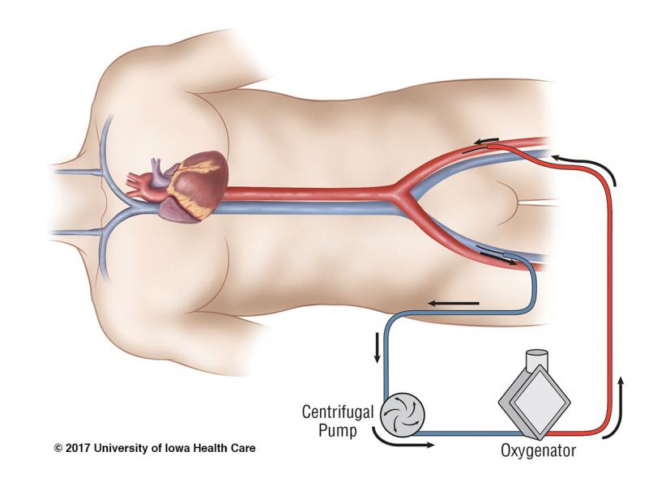
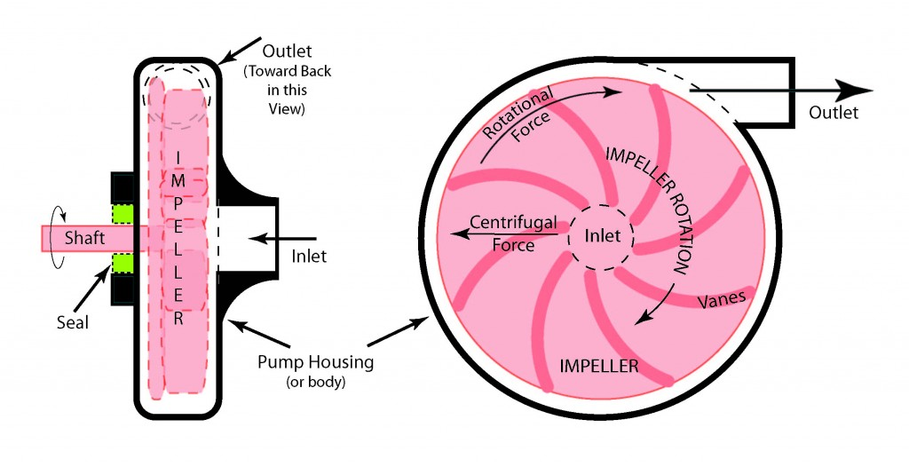
MCS: VA-ECMO – Theory
Notes:
I’m only going to touch briefly on ECMO here due to time constraints, but basically ECMO sucks blood from a large vein (usuall fem, but can be IJ), oxygenates it, and then uses a centrifugal pump to blast the blood back into a large artery (almost always fem V). It’s main advantage is oxygenation and its ability to provide massive circulatory support. But it correspondingly causes huge alterations in normal physiology- because the blood is blasted into the femoral artery, it causes a huge amount of flow that the heart is working against. It can lead to severe LV dilation and pulmonary edema and does the opposite of unloading the LV, which if you remember was an important component of cardiac support that we need from MCS devices. To that end VA-ECMO is often coupled with other devices such as the Impella or IABP to try to reduce this massive increase in LV load.
VA has large hematologic risks as well due to it using a centrifugal pump, which causes acquired vWD and hemolysis, while also forcing the patient to be on heparin. ECMO should really be preserved for patients who have no other options from both a pulmonary and cardiac stand point.
We have VA ECMO at county, but the pump is limited to a flow of 4.5-4.6lpm.

Slide 50
MSC Notes
Options: IABP, Impella, Tandem Heart, ECMO and more
MCS greatly increases bleeding risk!
Temporary support that buys time
Limited evidence for efficacy
Door to Support?

Slide 51
Ms. S
Should we use MCS?
Comfort care

Slide 52
Some finishing points
Things we did not cover: evidence, PA catheters
Stable heart failure management
Pump Problem
Neurohormonal Dysregulation Problem
Part 2 to be covered by Nacho!

Slide 53
We’re here to help!!!
Jeffrey Tran
818 390 4455
jeffreytran@email.arizona.edu

